Slide 1
This Week: Pandas
Module 4

Slide 2
This Week: Pandas
By the end of this week, you’ll know how to:
Read an external CSV file into a DataFrame.
Determine data types of row values in a DataFrame.
Format and retrieve data from columns of a DataFrame.
Merge, filter, slice, and sort a DataFrame.
Apply the groupby() function to a DataFrame.
Use multiple methods to perform a function on a DataFrame.
Perform mathematical calculations on columns of a DataFrame or Series.

Slide 3

This Week’s Challenge
Using the skills learned throughout the week, help a mock school board with their investigation by adjusting specific data.

Slide 4
Today’s Agenda
Module 4

Slide 5

Today’s Agenda
By completing today’s activities, you’ll learn the following skills:
01
Working with DataFrames
02
Segment and sort values into bins
Make sure you’ve downloaded any relevant class files!

Slide 6
How comfortable do you feel with this topic?

Slide 7

Cleaning Data

Slide 8
When dealing with massive datasets, it is almost inevitable that duplicate rows, inconsistent spelling, and missing values will crop up.

Slide 9
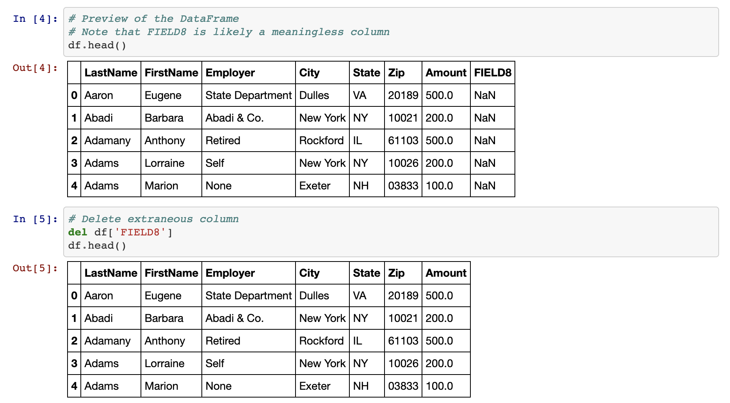
Cleaning Data
del <DataFrame>[<columns>]

Slide 10
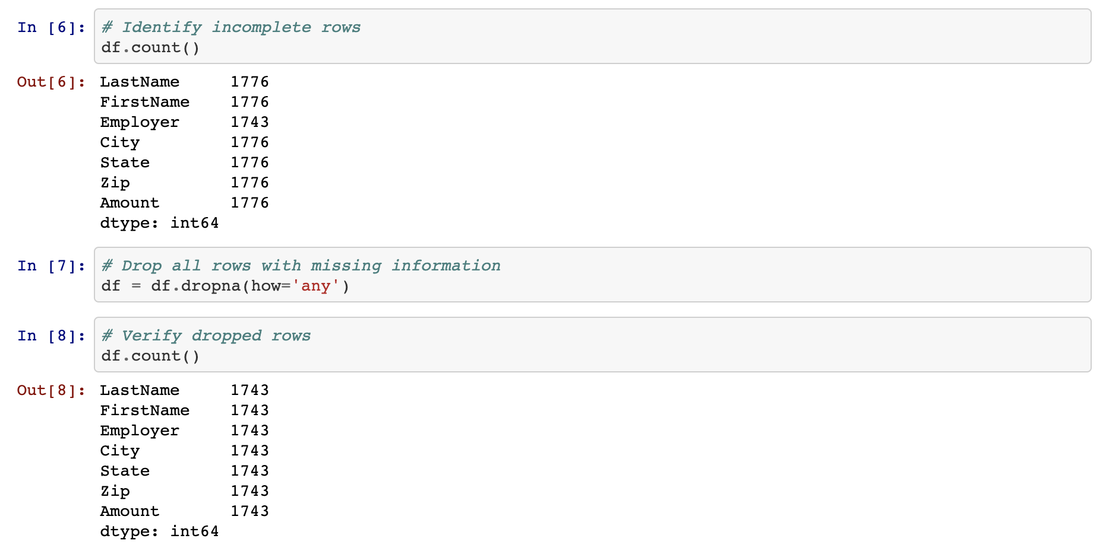
Cleaning Data
count()
<DataFrame>.dropna(how=’any’)

Slide 11
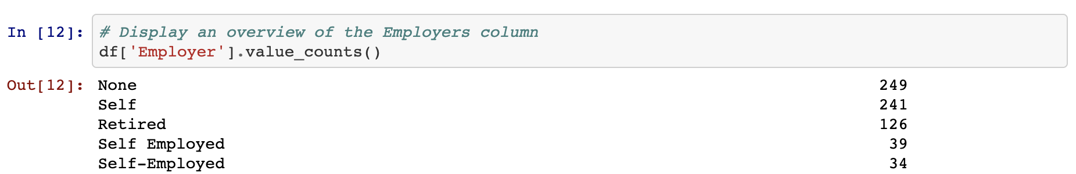
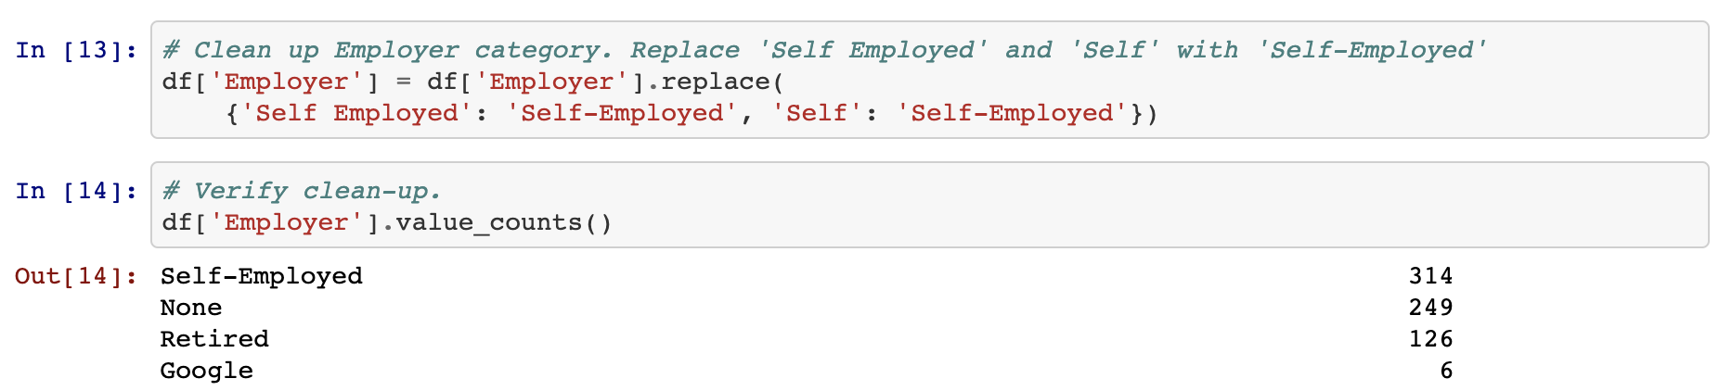
Cleaning Data
value_counts()
replace()

Slide 12
Cleaning Data
count() | To look for missing values, we use the count() method on the DataFrame.
dropna(how="any") | To drop rows with null values, we use dropna(how="any"), then verify the counts.
value_counts() | To look for any misspelled offenses and to find if similar offenses can be combined, we use value_counts() on the Offense Type column.
replace() | We combine similar offenses using the replace() method on the column in question and pass a dictionary into it, with the keys being those values to replace and the value being a common offense in the column.

Slide 14
Activity: Portland Crime
In this activity, we will take a crime dataset from Portland and do our best to clean it up so the DataFrame is consistent and has no rows with missing data.
15 Minutes

Slide 15
Exploring Data With loc and iloc

Slide 16
Programers can easily collect specific rows or columns of data from a DataFrame using the loc() and iloc() methods.

Slide 17
loc and Iloc

Slide 19
Activity: Good Movies
In this activity, you will create an application that looks through IMDB data in order to find only the best movies out there.
15 minutes

Slide 21
Pandas Grouping

Slide 22
The .groupby() function allows you to group Pandas objects based on a common record.

Slide 23
GroupBy

Slide 25
Training Groupby
In this exercise, you will work in pairs and use groupby() to get the average weight and length membership of the gym members for each trainer.
15 minutes

Slide 28
How would we sort the DataFrame from greatest to fewest length of membership in days?

Slide 29

sort_values(by='Membership (Days)', ascending=False) on the trainers_means DataFrame.

Slide 31
Binning Data

Slide 32
The ‘binning’ method is an effective function that places values into groups to allow a more vigorous customization of datasets.

Slide 33
Binning Data
Understand
Visualize
Function
Not everyone is a numbers person, and sometimes there are so many values within a DataFrame that it becomes difficult to comprehend what exactly is going on.
Grouping these values in bins can make it easier to visualize large datasets.
Using the Pandas pd.cut() function will allow us to "bin" values into groups, which enables more vigorous customization of datasets.

Slide 34
Binning Data

Slide 36
Activity: Binning TED
In this activity, you will create bins for TED Talks based on their viewership. After creating the bins, you’ll group the DataFrame based on those bins, and then perform some analysis on them.
20 minutes

